Slide 1
Implementing Dynamic Data Structures
IN628 Intermediate Architectures and Algorithms
Session 3.1
Semester 2, 2016
Notes:
OK. The actual topic…

Slide 2
Data Storage for Games
How can we store all the data needed to represent the objects in our game?
Notes:
We’ve said several times that games programming illustrates all the core issues. Here is another.
Enemy ships, pellets, monsters, power-ups, gems, etc. etc. etc.

Slide 3
Static Storage
Arrays
Advantages:
Easy to create and initialise
Easy to index into
Built-in in most development environments
Disadvantages:
Inflexible size
Awkward for deletion
Notes:
Size has to be declared in advance (modulo some languages that let you grow arrays dynamically)
Too small, can’t hold enough items
Too large, is wasteful.
Deletion: Leave the other items in place, and you have lots of gaps. Shift everybody around, and it takes time.
A better solution is…..

Slide 4
Dynamic Storage
Linked lists
Monster
Monster
Monster
Monster
Notes:
You grow and shrink your lists of items as required during the lifetime of the program
An item now contains a link to another item of the same type…
You can build a chain of items
All data operations (add, delete, search, etc.) are possible on linked list

Slide 5
Dynamic Storage
Linked lists
Head
Tail
Monster
Monster
Monster
Notes:
To operate on linked lists, we need to know where their first and last nodes are. Thus we maintain special pointers to the head and tail.
In fact, as we shall see, the *only* thing a linked list needs to store is its head and tail pointers. It doesn’t actually store the nodes at all.
Given the head and tail, and on the assumption that all the nodes in the list are correctly hooked together, the list can be traversed, giving access to all the nodes, without having to explicitly store their locations.
But we’ll get to that in a minute. First, let’s look more closely at those nodes. What kind of classes can you build a linked list out of…?

Slide 6
Generic Structure of a Node Object
Node
//Object Data and Methods
Node^ Next;
Notes:
Answer, pretty much any kind of class can be a linked list node.
Nodes are simple objects
Here is their generic structure
Note the Next pointer is a pointer to another element of the same type: the next node in the list
Note that Next is capitalised for a reason….
And what about the list itself…?

Slide 7
Generic Structure of a Linked List
LinkedList
Node^ head;
Node^ tail;
Notes:
That’s all. The list object doesn’t own any nodes directly.
It just keeps track of the head and tail nodes.
This is all it needs to insert, delete, traverse, etc., i.e. to perform all required list operations.

Slide 8
Linked List Operations
To create a linked list
Create a head node pointer
Create a tail node pointer
Set the value of both head and tail to nullptr
Notes:
Lists are empty when they start.
Be careful not to let pointers contain garbage. That’s a memory address, and it might be the kernel
Always set “empty” pointers to the null value for the language & environment you are working in
Note that the way to express “nullness” is different in different languages. In C# we said Null (I think), but in C++/CLI we say nullptr.
You are going to be able to tell when lists are empty, and when you have gotten to the end of a list (so you don’t fall off) by looking for these null pointers.
If you don’t initialise correctly to nullptr, the standard algorithms for linked list operations will not work.

Slide 9
Linked List Operations
To count the number of elements in a linked list
nodeCount = 0
Start at the node pointed to by head
Loop for all nodes
++nodeCount
Go to the next node in the list
Move through the list by following the Next pointers
You’ll know you have reached the end of the list when the Next pointer of the current node points to nullptr (i.e. there is no next node in the list)
Notes:
The pseudocode
Move through the list by following the Next pointers: We will see the code for this in a minute.

Slide 10
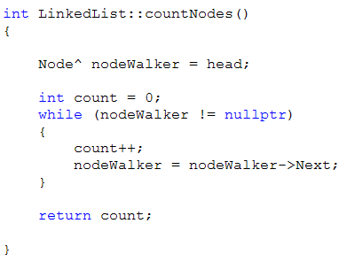
Linked List Operations
To count the number of elements in a linked list
Notes:
The real code for a class called LinkedList
That class will, of course, include Node.h so that it can see that data type.
Note how critical it is that Next always be initialised to nullptr in the constructor. If you don’t do this, the while is infinite (or until it breaks the computer).

Slide 11
nodeWalker = nodeWalker->Next
nodeWalker is a Node pointer
It is NOT a Node.
It has no “Next” property
So how can we talk about its ‘Next’?
When working with pointers, ptr->Next does not mean “Your Next property”
It means “The Next property of the object you are pointing at”
Notes:
Let’s think about this briefly
NodeWalker is a pointer
It is 32 or 64 bits of memory that can hold an address, which should be the address of a Node
It is not a Node
It doesn’t have any of the properties of a Node, so what does it mean to say NodeWalker->Next?

Slide 12
nodeWalker = nodeWalker->Next
So
nodeWalker = nodeWalker->Next
Means
Find the guy nodeWalker is pointing at
Take that guy’s Next value
Assign that value to nodeWalker
Notes:
When we “assign that value to nodeWalker, where is he now pointing? To the guy his previous guy was pointing to. That is, he has taken one step down the chain.

Slide 13
nodeWalker = nodeWalker->Next
NodeWalker
Node1
Node 2
Notes:
NodeWalker points at Node1
The Next of Node1 is the address of Node2

Slide 14
nodeWalker = nodeWalker->Next
NodeWalker
Node1
Node 2
Notes:
So NodeWalker = NodeWalker->Next points NodeWalker at Node2
What if we did it again?
Node2, being at the end of the list, his Next = nullptr
So if you say NodeWalker=NodeWalker->Next again, NodeWalker is nullptr
That’s how you drop out of the loop

Slide 15

Linked List Operations
To add a new node to an unordered linked list
Add it to the end
Process
Set the Next pointer of the current last node to the new node.
Set tail to point to the new node.
Notes:
Draw “adding to the end”
How can we talk to “the current last node”? Tail is pointing to him.
Remember, Tail->Next means “the Next of the guy Tail is pointing to
One question: What if there aren’t any nodes in the list (that is, you are adding the first node)?
What is the value of tail (that is, what it tail pointing to)? => nullptr
What will happen when you say tail->Next (which means “the Next field of the guy tail is pointing to)? => Boom
What can you do? => Recognise that this is a “special case”. This is very common. We have the ordinary thing we do most of the time, and we have the boundary cases.

Slide 16
Adding to a Linked List
If the list isn’t empty (i.e. tail isn’t nullptr), add the new node to the end.
If tail is nullptr?
Make both head and tail point to the new node.
Notes:
Draw
What flow of control structure will we need? => if-else

Slide 17
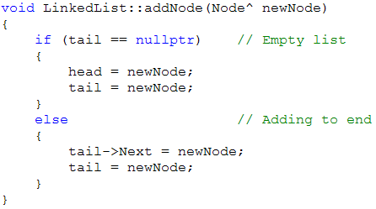
Adding to a Linked List
Notes:
Here is the complete add method
Note the here we have passed in a ready-made node.
Could you make your LinkedList add a node given just the starting data? That is something you might want to let the programmer do.
How? => Overload your add method.

Slide 18
Linked List Operations
To delete a node
Head
Tail
Monster 1
Monster2
Monster 3
Notes:
To delete monster2…

Slide 19
Linked List Operations
To delete a node
Head
Tail
Monster 1
Monster2
Monster 3
Notes:
To delete monster2…simply set

Slide 20
Linked List Operations
Monster1->Next = Monster2->Next
Head
Tail
Monster 1
Monster2
Monster 3
Notes:
To delete monster2…simply set

Slide 21
Linked List Operations
Monster2’s memory will be GC’d
Head
Tail
Monster 1
Monster 3
Notes:
We can delete it now if we want (we’ll see how later) or we can just let it be GC’d
The system will see that nobody points to it anymore, and will free it.

Slide 22
Deleting continued
But how would we find Monster1 (i.e. the node before the one we want to delete)?
Algorithm
Start at the beginning.
For each node ask “Is the node after this one (i.e. its Next) the one who is to be deleted?”
If so, it is the “previous” node.
Set the Next of the “previous” node to the Next of the node to be deleted.
Notes:
Imagine the node you want to delete is somewhere in the middle of the list.
Remember these nodes are really scattered all over in memory.
You only know the address of the node you want to delete.
You can get the address of the node after him by looking at his Next, but how can you get the address of the node before him?
(Someone may suggest doubly-linked list here. A good example of the right data structure for the right job. But assume you don’t want to hassle with the overhead of a DL List.)

Slide 23
Deleting continued
Delete Monster3
Head
Tail
Monster 1
Monster2
Monster 3
Monster4
NodeToDelete
Notes:
The algorithm in action

Slide 24
Deleting continued
Delete Monster3
Head
NodeWalker
Tail
Monster 1
Monster2
Monster 3
Monster4
NodeToDelete
Notes:
Start at beginning
NodeWalker = Head

Slide 25
Deleting continued
NodeWalker = NodeWalker >Next
Head
NodeWalker
Tail
Monster 1
Monster2
Monster 3
Monster4
NodeToDelete
Notes:
Move along

Slide 26
Deleting continued
NodeWalker = NodeWalker ->Next
Head
NodeWalker
Tail
Monster 1
Monster2
Monster 3
Monster4
NodeToDelete
Notes:
Check to see if this is the “previous” node

Slide 27
Deleting continued
NodeWalker ->Next now equals NodeToDelete
Head
NodeWalker
Tail
Monster 1
Monster2
Monster 3
Monster4
NodeToDelete

Slide 28
Deleting continued
NodeWalker ->Next = NodeToDelete->Next
Head
NodeWalker
Tail
Monster 1
Monster2
Monster 3
Monster4

Slide 29
Deleting continued
Monster3 will be GC’d
Head
NodeWalker
Tail
Monster 1
Monster2
Monster4

Slide 30
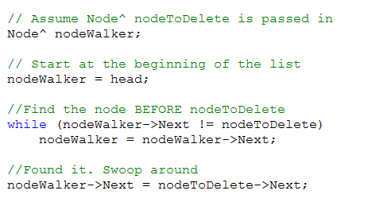
Deleting continued
Notes:
The code…
Note that there’s actually a little more to it than we have seen here.
We need to deal with the case where we are asked to delete a node that isn’t actually in the list (could happen, best to be safe), and there are boundary cases, for example, when you are deleting the first node, or deleting from a list that only has one node in it. Then there is no “node before”.
When we build our own linked lists, we will look at these, and there is a detailed handout to help you.
For now, just make sure you understand the logic of this basic case of deleting a node from the middle of a list.
Use a similar approach for adding a node to an ordered list.

Slide 31
Generic Structure of a List
private:
Node^ head;
Node^ tail;
public:
//List Operations
Notes:
That’s all
Why doesn’t it need to store its nodes? (because it can reach any – or all – nodes using only head, tail and walking the chain.)

Slide 32
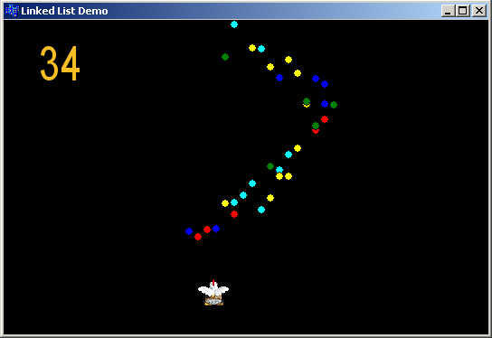
Project: The Incredible Rainbow Spitting Chicken
Notes:
Chicken moves left and right with arrow key.
Spits a pellet on spacebar
Pellets are stored in linked list
Pellets removed when they go off the screen
Number shows count of currently live pellets
Demo on the I: drive
You are going to build this application this week.
First you will need to implement the Pellet and the complete PelletList class with all the linked list functionality.
Then use these classes to build the application.
More details and suggestions are given in the handout.

Slide 33
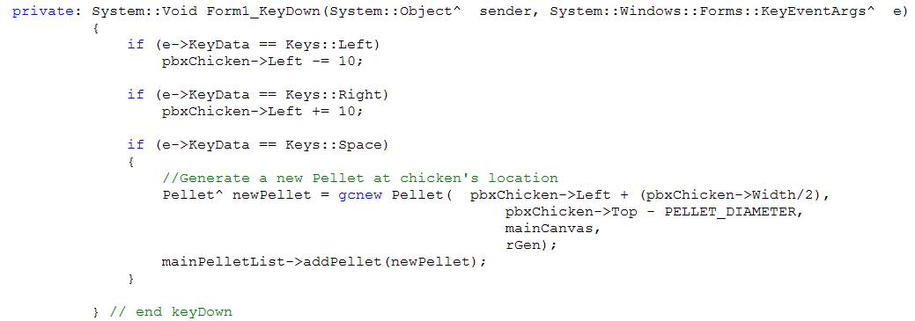
KeyDown in Visual Studio
Notes:
One technical note…
Accessing via the Events tab (lightning bolt in properties window)
The keydown event handler sends you in a bunch of data in a KeyEventArgs object called e.
e->KeyData tells you which key was pressed. Note that we use the .NET enumeration Keys to refer to the left and right arrow keys.
Here we also see the preparation of the pellet.
What’s all that Width/2 and Top-diameter stuff for? (xPos & yPos are the upper left. These adjustments make it look like the pellet is coming from the beak.)
Where are rGen and mainCanvas declared? (up above as class members) Where are they instantiated? (in the form_load)

